Slide 1
Rise & Shine Café
Start the day off right!
Great food, coffee, & company.
Fresh, Local, Made to Order

Slide 2
Overview: Product & Place
Product: Conventional style breakfast menu
Emphasizes build-your own, healthy options
Diet-specific items can be customized (substitutions)
Examples include egg-free, gluten-free, and vegan options
Place: located in the Gallatin Field Airport
Counter Service: Grab n Go style with seating area
Bright and Friendly atmosphere, colorful and animated
Clients: Business people, families, & travelers

Slide 3
Overview: Price & Promotion
Price: moderately priced, depending on complexity of the item ordered
Extra meats and veggies: extra charges
Lack of competition= more freedom to vary prices
Promotion: Coupons/fliers in Belgrade& Bozeman newspapers
Phone book advertisements
KGLT advertisements
Daily specials & sunday brunch promotionals

Slide 4
Menu - Signature Entrées
Breakfast Wrap…………………………………………………………………………………………….………..…$6.⁹⁵
Free-range egg scrambler with sautéed onion, zucchini, bell pepper and carrot, plus sausage and home fries all in a whole-wheat tortilla.
Waffles…………………………………………………………………………………………………………..……...…$7.⁹⁵
Home-made waffles made with whole-wheat served with fresh fruit salad and sausage.
(Gluten-free and vegan waffles available)
Egg-free Scramble………………………………………….…………………………………………………….…$8.⁹⁵
Tofu specially prepared with sautéed onions and chickpeas and topped with fresh tomato and avocado. Served with home fries and veggie sausage. (Egg scramble available)
Compost Plate…………….……………………………………………………………………………………....……$8.⁹⁵
A heaping pile of all our plant-based options, including egg-free scramble, waffle, toast, veggie sausage & bacon, home fries, topped with condiments of your choice.
Quiche of the Day………………………….……………………………………….………………………$4.⁹⁵/slice
A rotation of egg and egg-free quiches made with varying veggies.

Slide 5
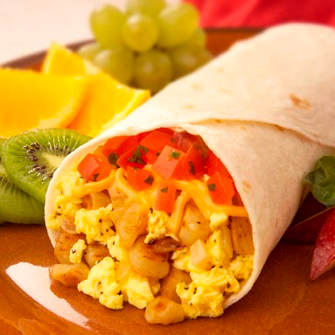
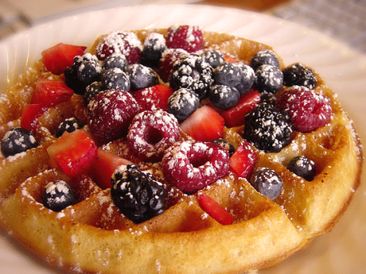
Customize
Create Your Own………………………………………..…….starting at $6.⁹⁹
Customize any of our signature entrees with your favorite veggies, meat and side dish.
Gourmet coffee options and Espresso Station

Slide 6
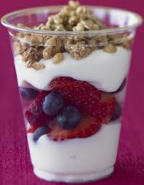
Create your own Sandwich, Wrap, Omelet, Parfait, or Smoothie
Select Bread, 1 Meat and up to 3 other items from list for only $6.99
Fruit & Yogurt Parfaits or Smoothies $4.99
Breads
Whole Wheat, Croissant, Bagel, English Muffin, Gluten Free
Meat: $.99 (for each additional item)
Bacon, Sausage, Ham
Vegetables: $.99 (for each additional item
Bell Pepper, Onion, Spinach, Tomato, Mushroom, Zucchini, Potato, sautéed vegetable mix, Tofu
Select up to 3 fruits. Add $.99 for each additional
Strawberries, Blueberries, Bananas, Oranges, Apples, Cantaloupe, Pineapple
Specialty Coffee

Slide 7
Sustainability Policy
Reduce, Reuse, Recycle
Install Energy Saving Equipment
Energy Star Appliances, water saving ware washers, low-flow toilets, energy efficient windows, sun lights
Run dishwashers only when full
Compact fluorescent lights
Motion Detector Lights in offices, storage rooms, bathrooms
Reuse furniture, flooring from recovered wood, recycled counter tops, biodegradable to go containers
Donate edible food leftovers to shelters & soup kitchens
Recycle Bins in waste area
Paper, Plastic, Glass, Aluminum
Compost Food Scraps

Slide 8
Sustainability Policy cont.
Train Employees in Energy Saving Procedures & Importance
Tell Customers about our energy efforts via posted signs
Purchase local products when available. Less travel -saving fuel
Support Local Farms
Buy eggs, meat, milk, wheat locally
Give back to the community
Donations
Support local schools & programs

